Slide 1
Fraud Detection ML Project
Sergey Hovhannisyan & Arnav Kanwal

Slide 2

Introduction
CCFD dataset is pulled from Kaggle
09/2013 European cardholders’ transactions
There are 284,807 total samples
Only 492 fraudulent transactions
Analyze & Prevent Frauds

Slide 3

Response Time
Prevent Frauds
Do Not Trust Yourself
Too Late
Real Time
Adapting to Habits

Slide 4

Data Preprocessing
Extremely Imbalanced (0.17% Fraud Ratio)
Feature Reduction (32->22 / Chi-Squared)
Randomized Small Subspace of Normals
Random Over Sampling Technique

Slide 5
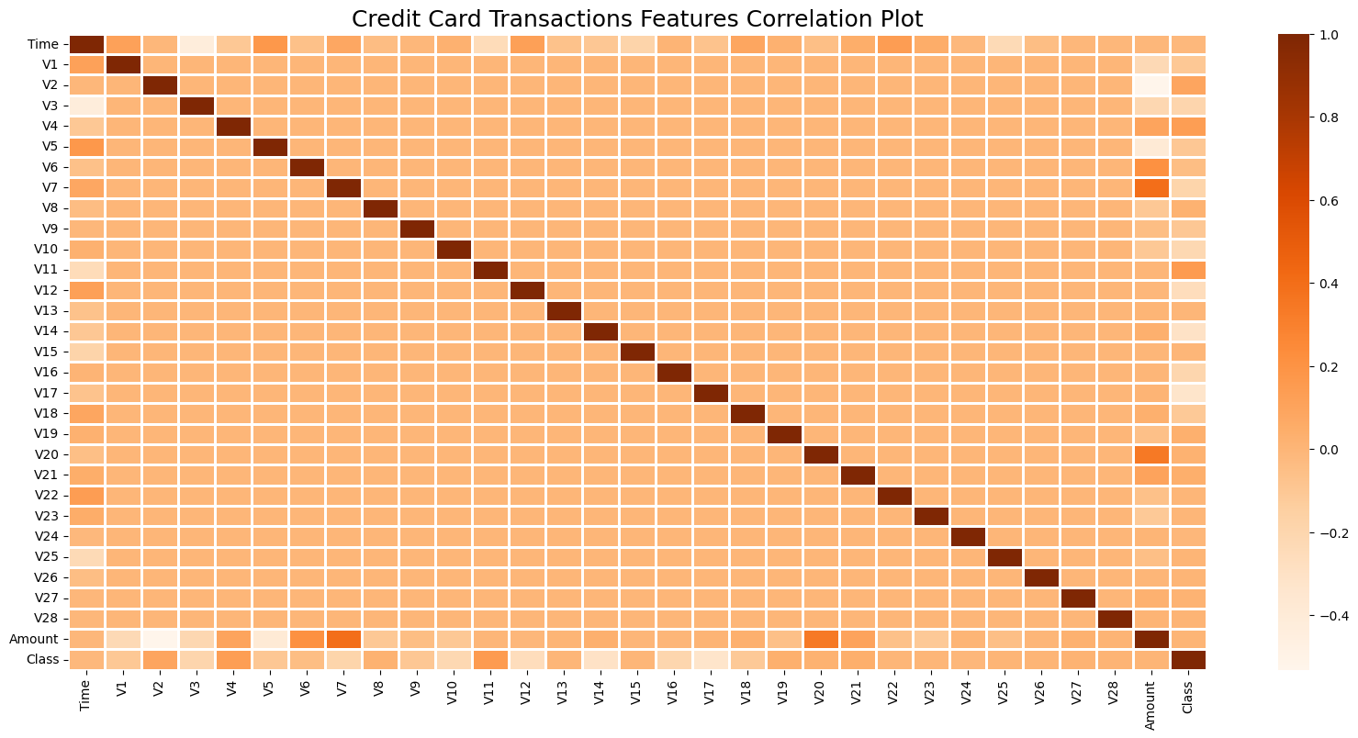
Correlation Matrix

Slide 6
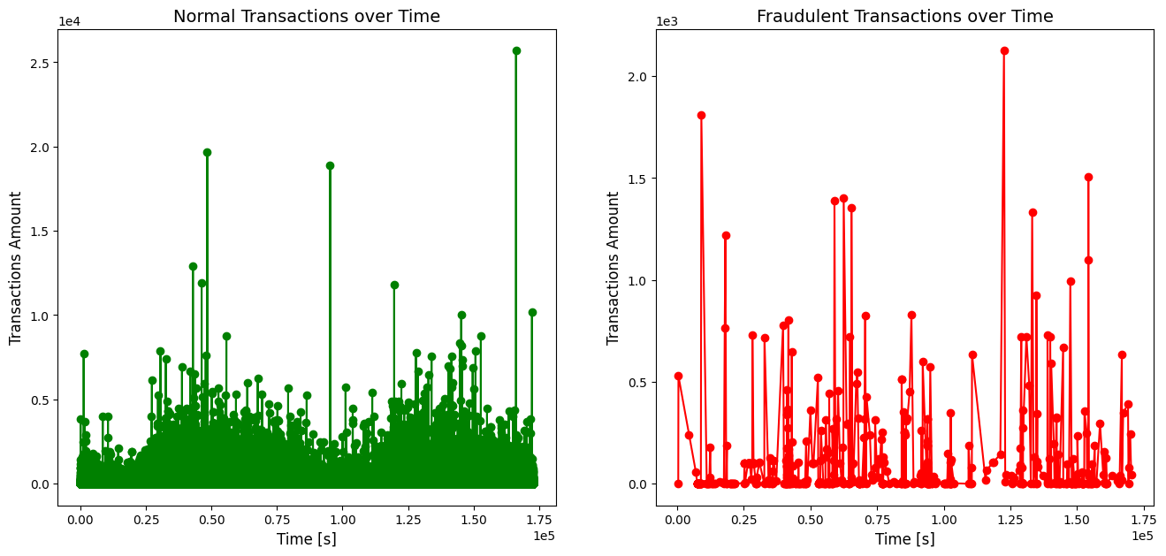
Frauds vs Genuine Transactions

Slide 7
Logistic Regression
Polynomial Feature Transformation without Regularization
K-Fold Cross Validation, L1 & L2 Regularization

Slide 8
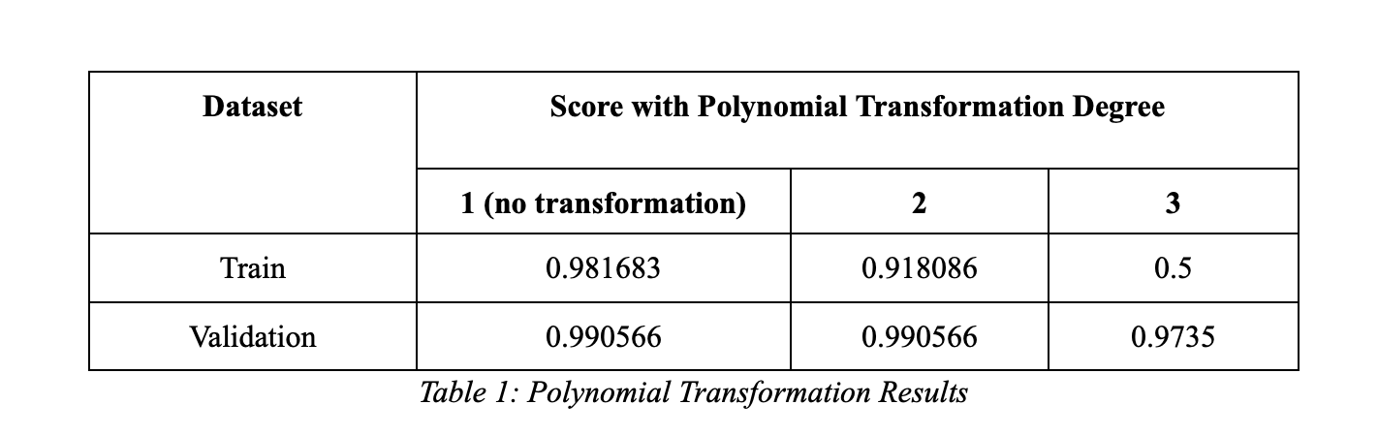
Polynomial Feature Transformation

Slide 9
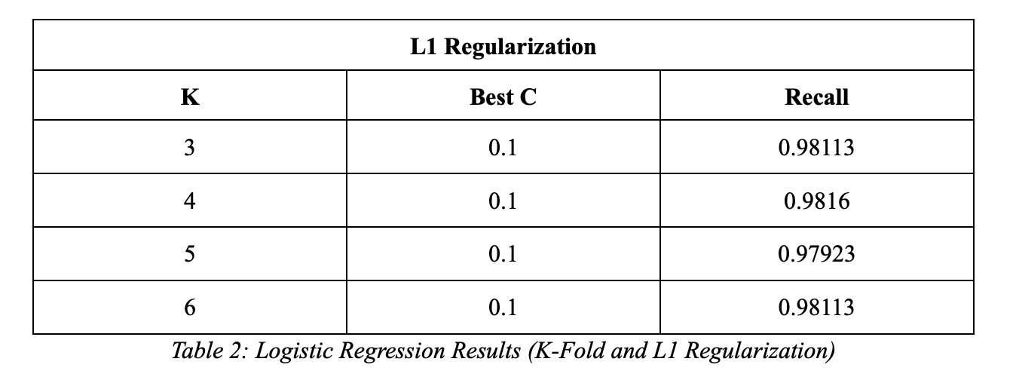
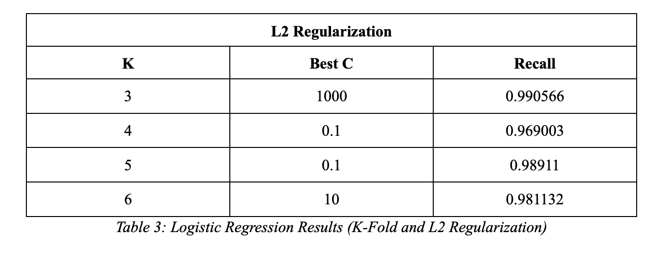
K-Fold Cross Validation Results
Testing range C = λ^-1 of 0.001 to 10000

Slide 10
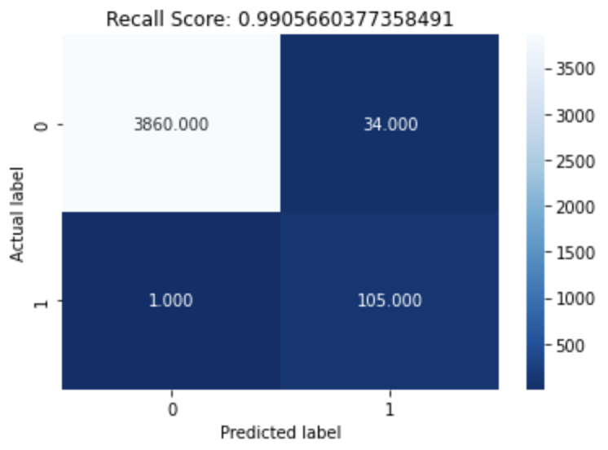
Logistic Regression Results
Overall, we get a test set recall score of 99.1%. Seems extremely accurate for detecting fraudulent transactions.
C = 1000
F1-score = 85.7%
No polynomial transformation and using L2 regularization.
Data is highly linearly separable.

Slide 11
Support Vector Machine SVM
Linear Kernel with L1 Regularization
Polynomial Kernel with L2 Regularization
RBF Kernel with L2 regularization

Slide 12
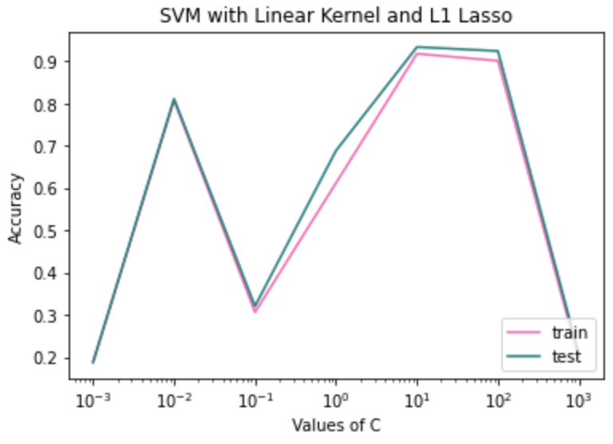
Linear Kernel
Worst Performance: C=0.001, Train Recall = 0.186947, Test Recall = 0.18867
Best Performance: C=10, Train Recall = 0.91808, Test Recall = 0.933962

Slide 13
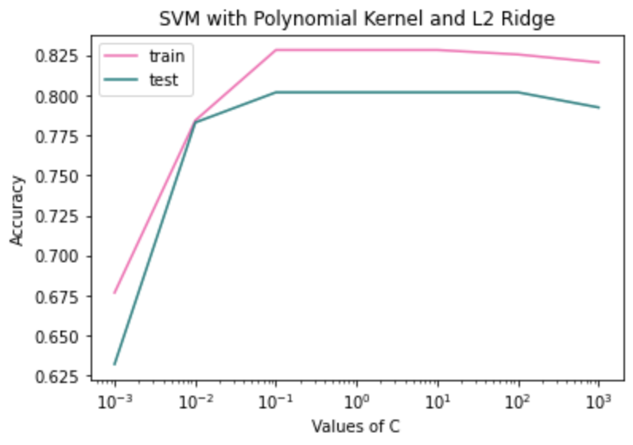
Polynomial Kernel
Best Performance: C=0.001, Train Recall = 0.6767, Test Recall = 0.632
Worst Performance: C=0.1, Train Recall = 0.8283, Test Recall = 0.8019

Slide 14
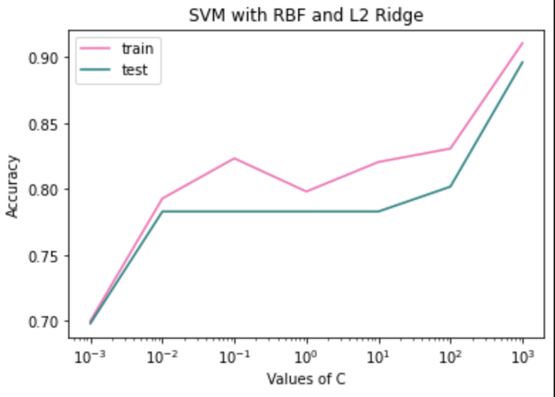
RBF Kernel
Worst Performance: C=0.001, Train Recall = 0.700012, Test Recall = 0.6981
Best Performance: C=1000, Train Recall = 0.91078, Test Recall = 0.8962

Slide 15
RBF Kernel
Worst Performance: C=0.001, Train Recall = 0.700012, Test Recall = 0.6981
Best Performance: C=1000, Train Recall = 0.91078, Test Recall = 0.8962

Slide 16
SVM - Results
Transformations are extremely expensive and did not perform better than linear kernel
Bottleneck of data is oversampling is not representative of actual fraudulent data but only increases the number of similar examples that exist
Best result is test recall of 0.934 (recall converges around this percentage)

Slide 17
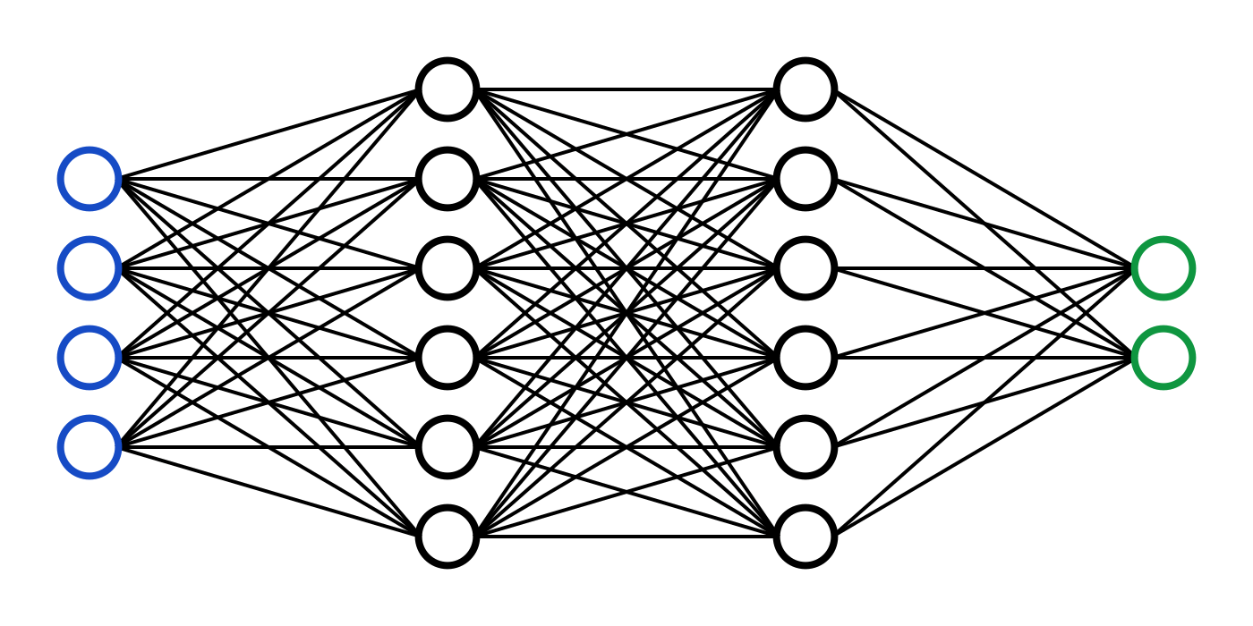
Neural Network
3 Layer (Poor)
2 Layer (Steady)
Number of neurons
Regularization

Slide 18

3 Layer ANN
Input Layer:
200 Neurons & L2 Reg. & ReLU
250 Neurons & L1 Reg. & ReLU
Hidden Layer:
150 Neurons & L2 & ReLU
100 Neurons & L1 & ReLU
Output Layer:
1 Neuron & Sigmoid

Slide 19
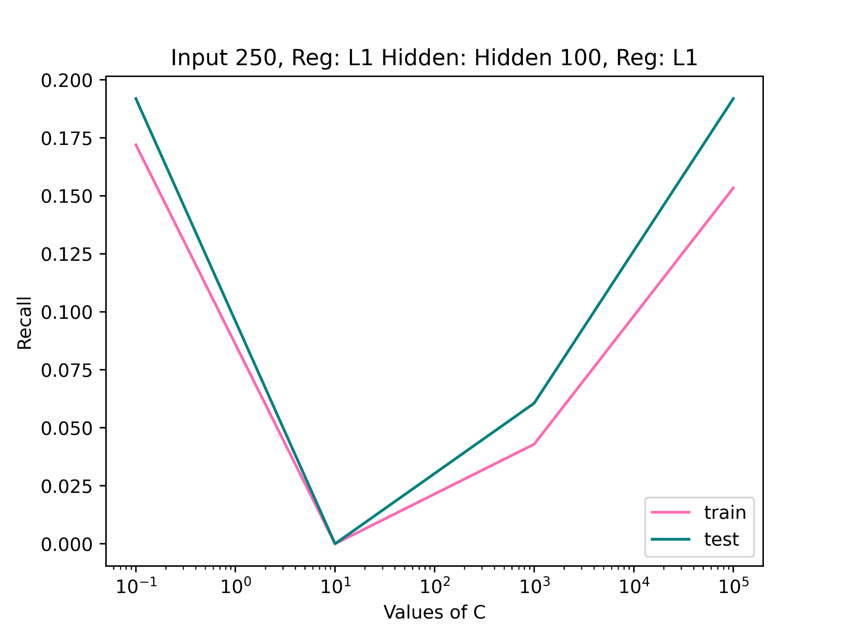
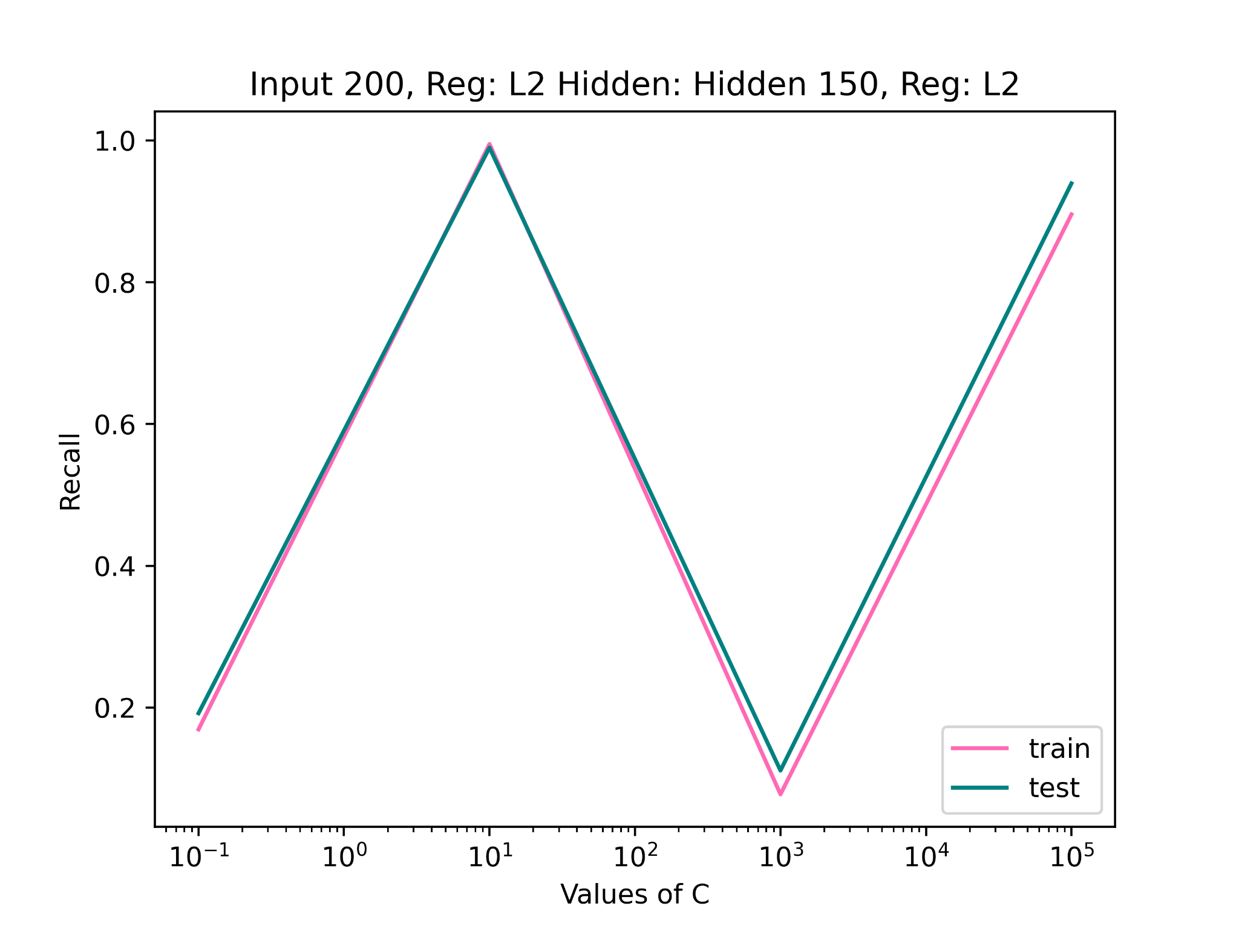
Recall vs C

Slide 20

2 Layer ANN
Input Layer:
200 Neurons & L2 Reg. & ReLU
250 Neurons & L1 Reg. & ReLU
Output Layer:
1 Neuron & Sigmoid
Max Recall: 0.98

Slide 21
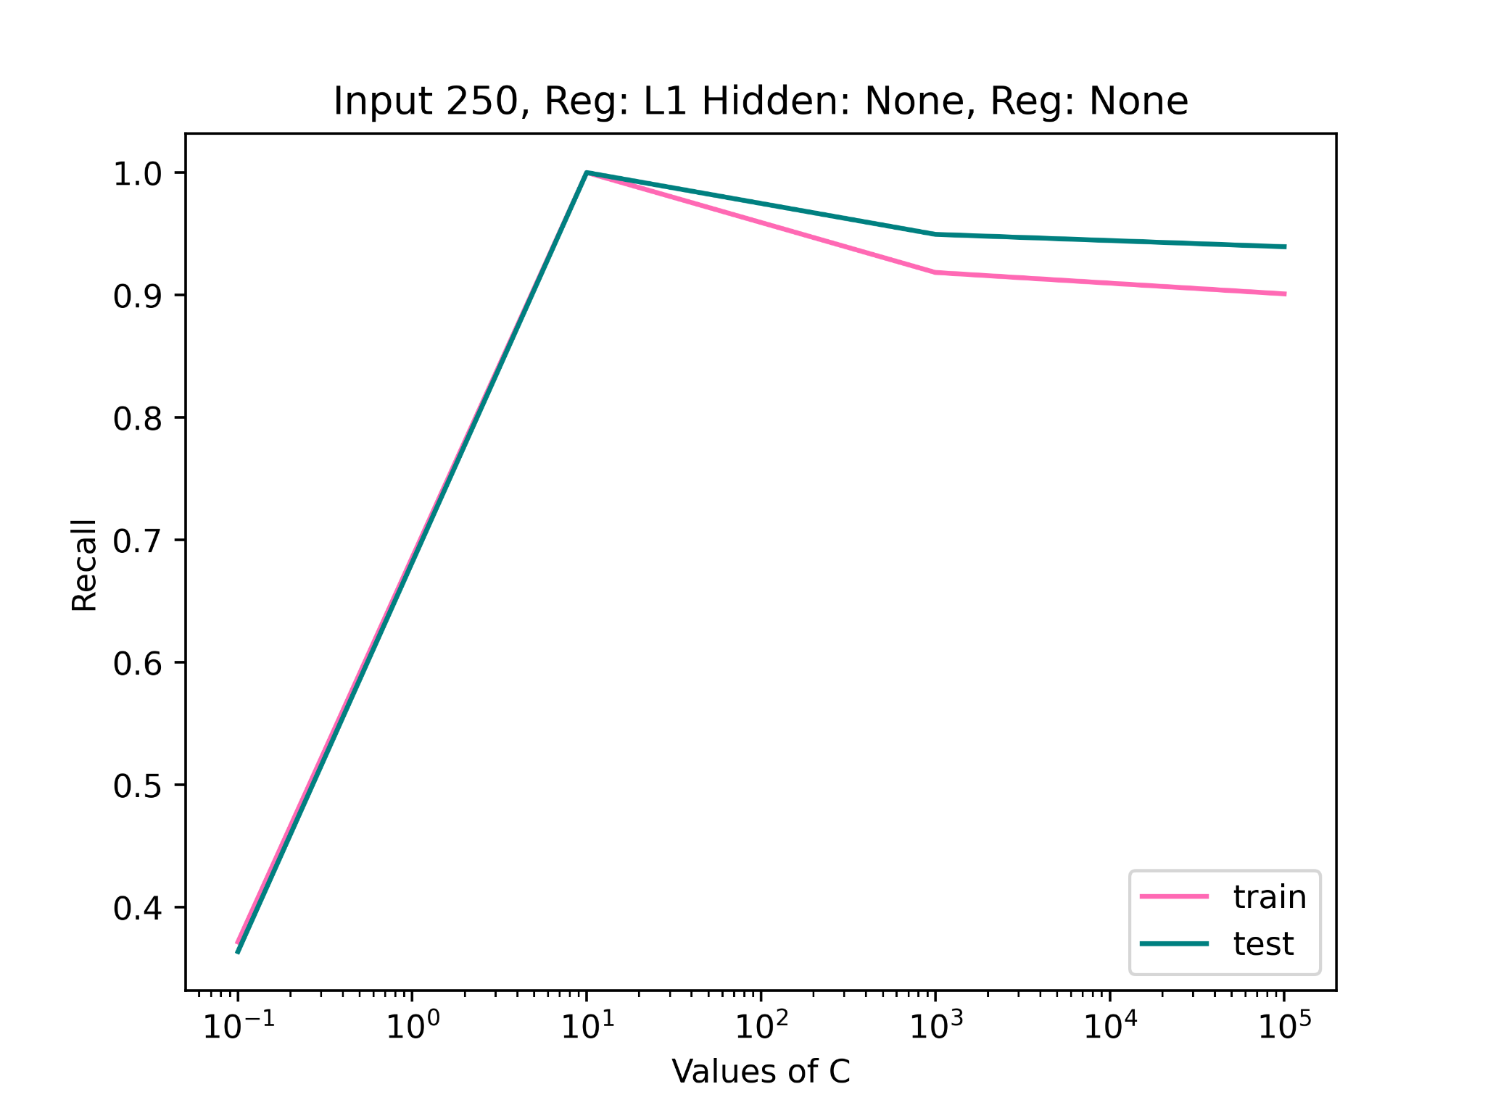
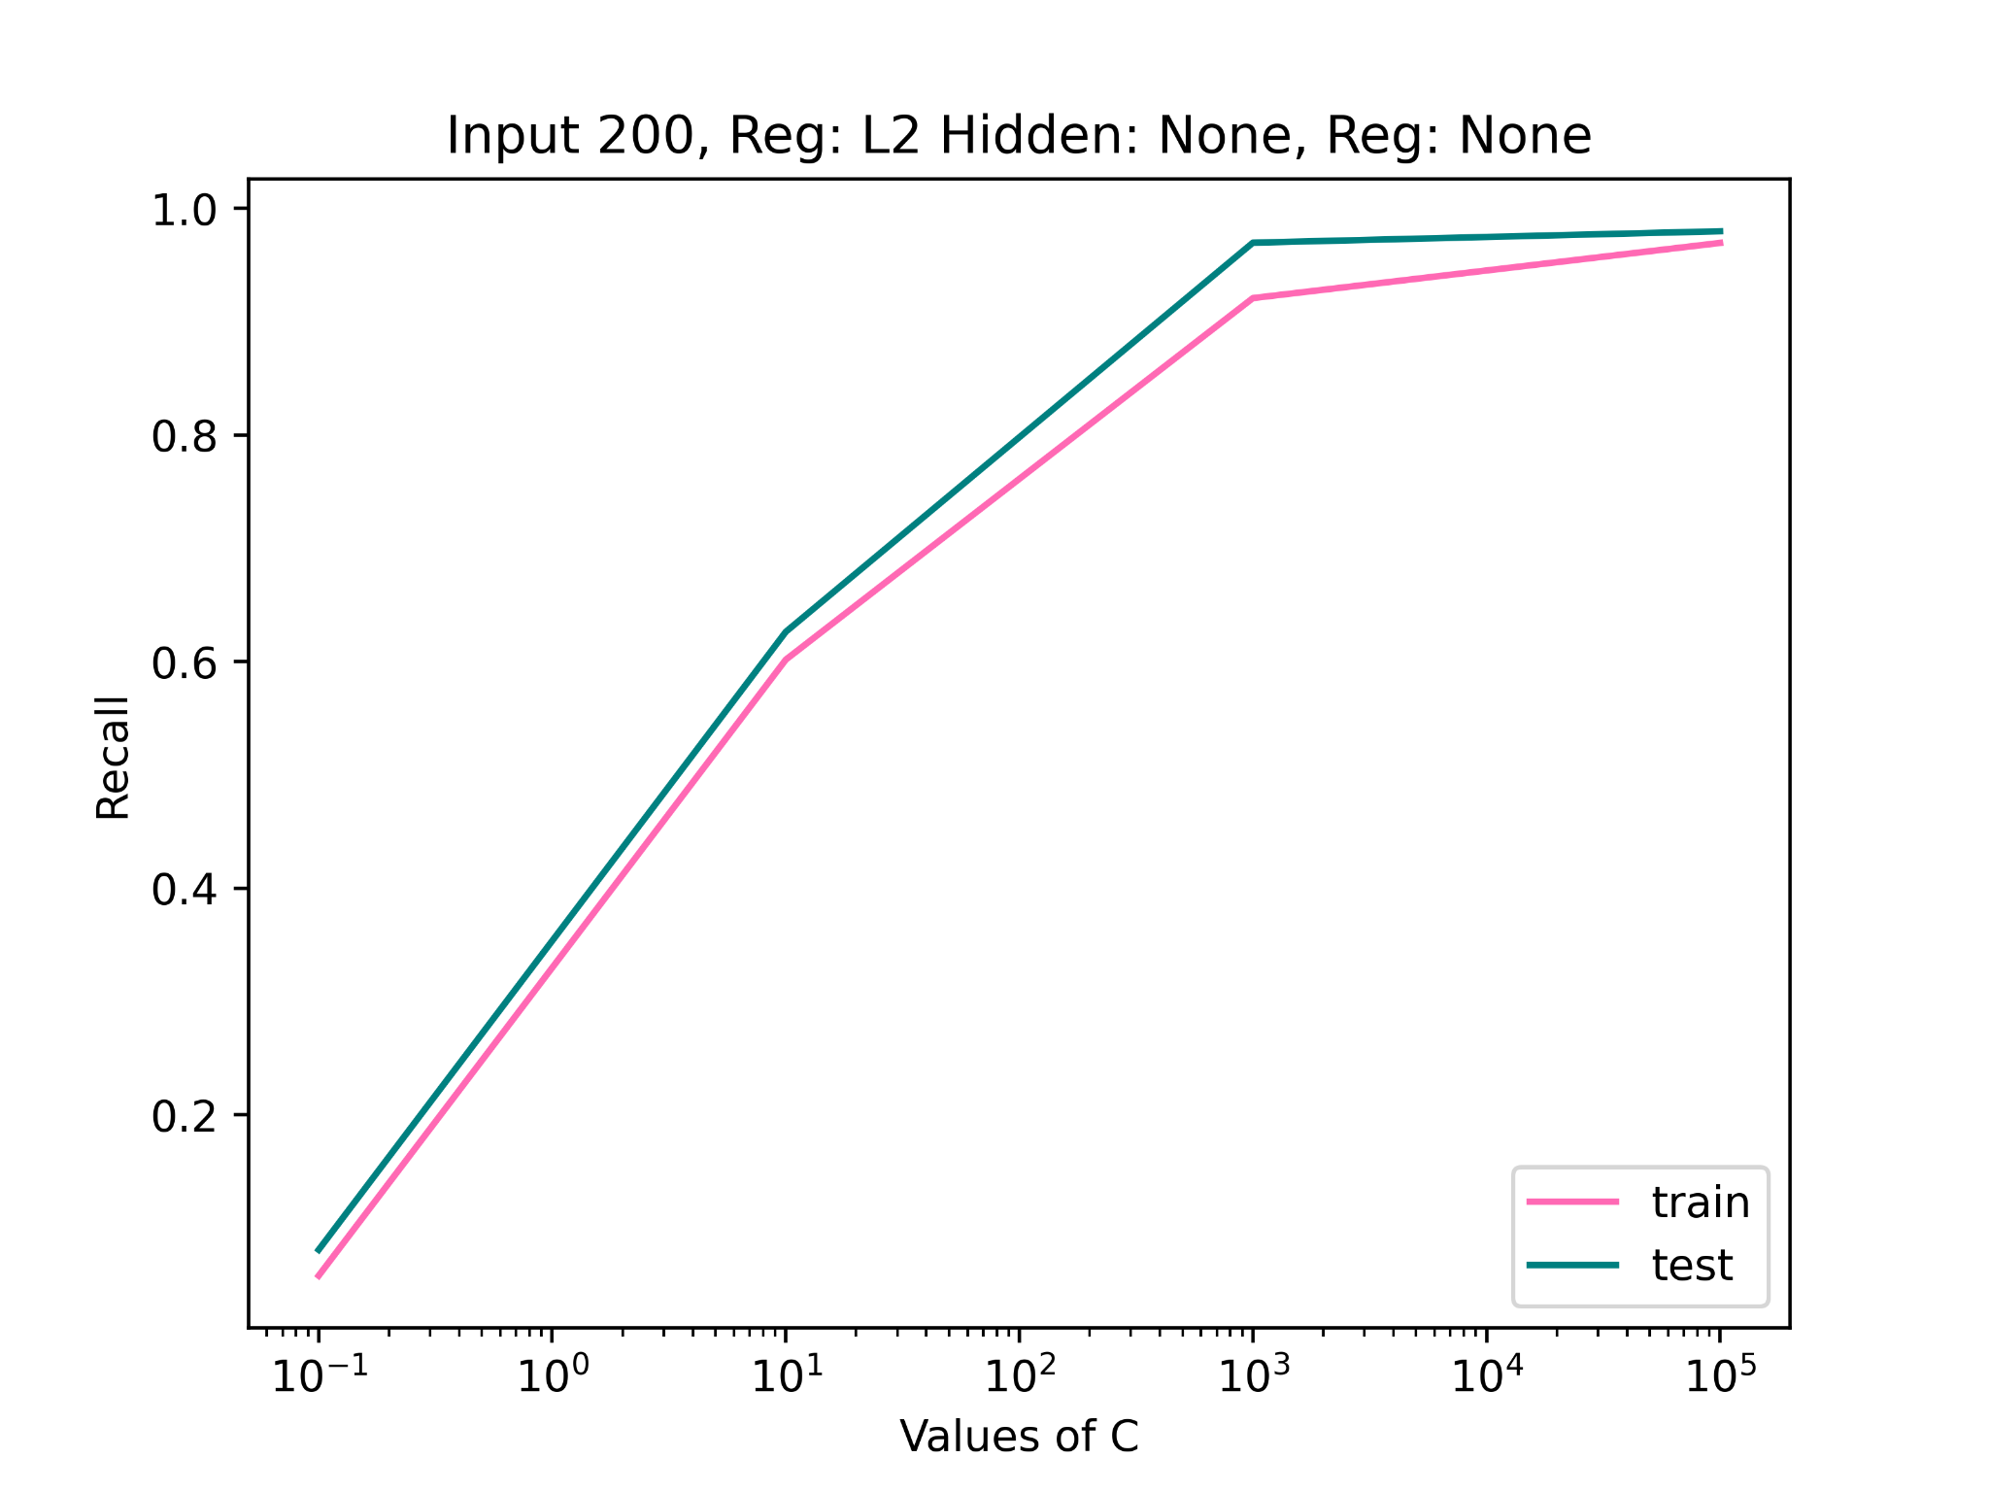
Recall vs C

Slide 22
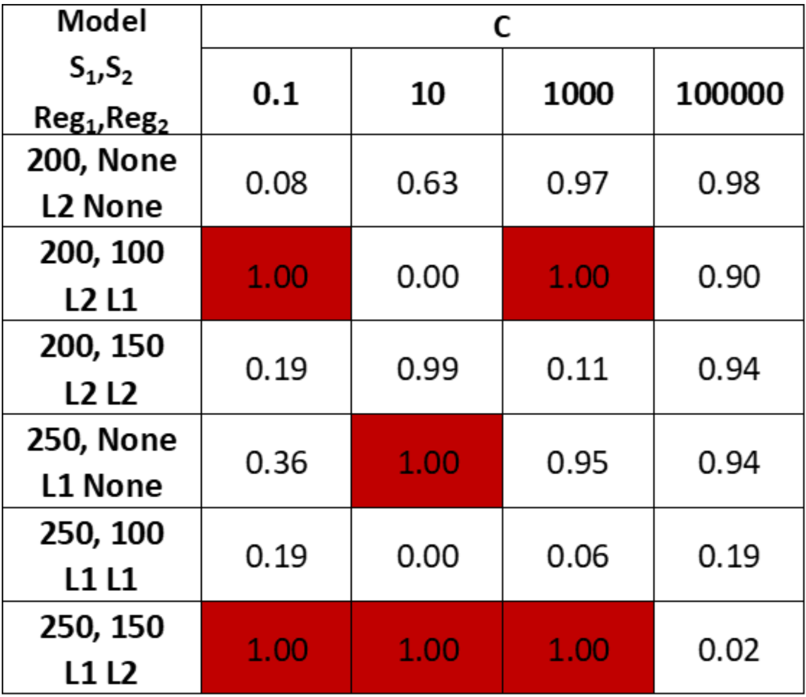
Recall Scores for All ANN Trained Models

Slide 23
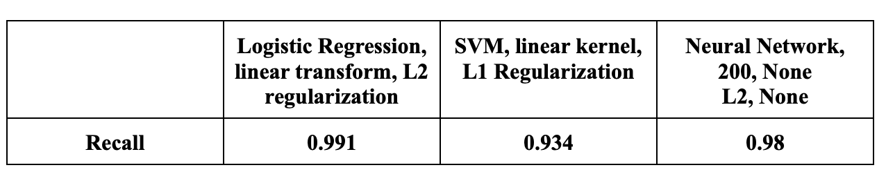
Final Results
Logistic regression, no transformation performs best
Bottlenecks:
Unbalanced data
Oversampling
High variance, low bias
Data is linearly separable
High recall and not a large number of false negatives

Slide 24
Works Cited
“Credit Card Fraud Detection,” Machine Learning Group - ULB, Kaggle, https://www.kaggle.com/datasets/mlg-ulb/creditcardfraud
Fawcett, Tom, “Learning from Imbalanced Classes,” Silicon Valley Data Science, 16 Nov. 2017, https://www.svds.com/tbt-learning-imbalanced-classes/
‌Galarnyk, Michael, “Logistic Regression using Python (scikit-learn),” Towards Data Science, 13 Sep 2017, https://towardsdatascience.com/logistic-regression-using-python-sklearn-numpy-mnist-handwriting-recognition-matplotlib-a6b31e2b166a

